Slide 1
Introduction to
Graph Neural Network
Neural networks have been adapted to leverage the structure and properties of graphs.
We explore the components needed for building a graph neural network - and motivate the design choices behind them.

Slide 2
GNN
Graphs are all around us; real world objects are often defined in terms of their connections to other things.
A set of objects, and the connections between them, are naturally expressed as a graph. Researchers have developed neural networks that operate on graph data (called graph neural networks, or GNNs) for over a decade.
Recent developments have increased their capabilities and expressive power.
We are starting to see practical applications in areas such as antibacterial discovery, physics simulations, fake news detection, traffic prediction and recommendation systems.

Slide 3
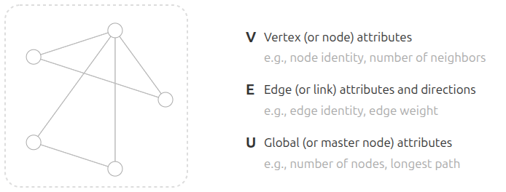
Graph
A graph represents the relations (edges) between a collection of entities (nodes).

Slide 4
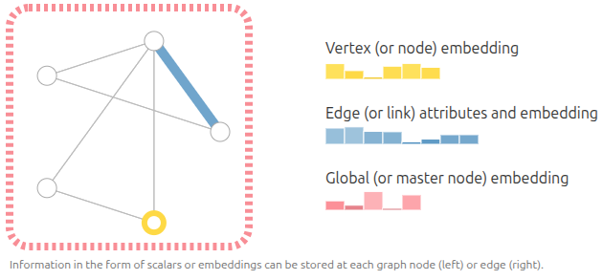

Graph
We can additionally specialize graphs by associating directionality to edges (directed, undirected).

Slide 5
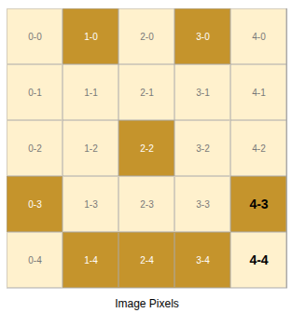
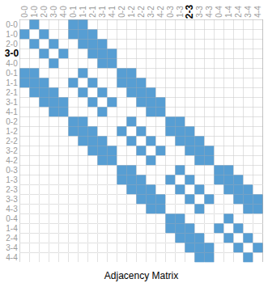
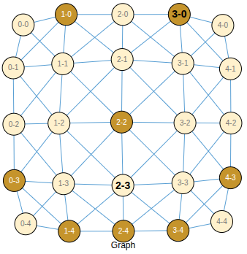
Graphs and where to find them : Images as graphs
Images are usually represented as rectangular grids with channels,
such as 244 × 244 × 3 RGB arrays.
In this graph representation:
  Each pixel is treated as a node.
  Each node is connected to its adjacent pixels by edges.
  Each non-border pixel has exactly 8 neighbors.
  Each node stores a 3-dimensional RGB vector.
Graph connectivity can be visualized using an adjacency matrix.
For a simple 5 × 5 smiley-face image:
  There are 25 pixels, so there are 25 nodes.
  The adjacency matrix has size n_nodes × n_nodes.
  A matrix entry indicates whether two pixels share an edge.
The grid image, graph view, and adjacency matrix
are three different representations of the same data.

Slide 6
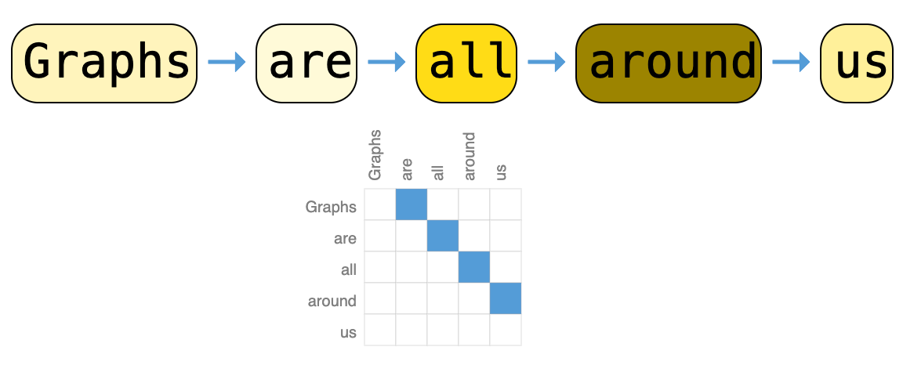
Graphs and where to find them : Texts as graphs
Text can be digitized by assigning indices to characters, words, or tokens.
A sentence becomes a sequence of these indices.
This sequence can be viewed as a directed graph:
  Each token is a node.
  Each node connects to the next token.
Example: “Graphs are all around us”
In practice, this graph view is usually redundant.
Images and text have very regular structures:
  Image adjacency matrices show grid-based banded patterns.
  Text adjacency matrices mostly form a diagonal line.

Slide 7
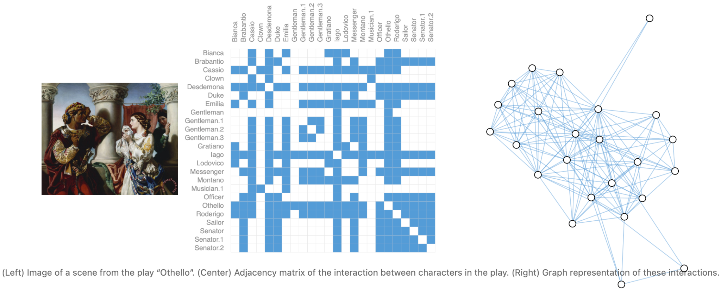
Graphs and where to find them : Social networks as graphs
Social networks are tools to study patterns in collective behaviour of people, institutions and organizations.
We can build a graph representing groups of people by modelling individuals as nodes, and their relationships as edges.

Slide 8
What types of problems have graph structured data?
In a graph-level task, we predict a single property for a whole graph.
For a node-level task, we predict some property for each node in a graph.
For an edge-level task, we want to predict the property or presence of edges in a graph.

Slide 9
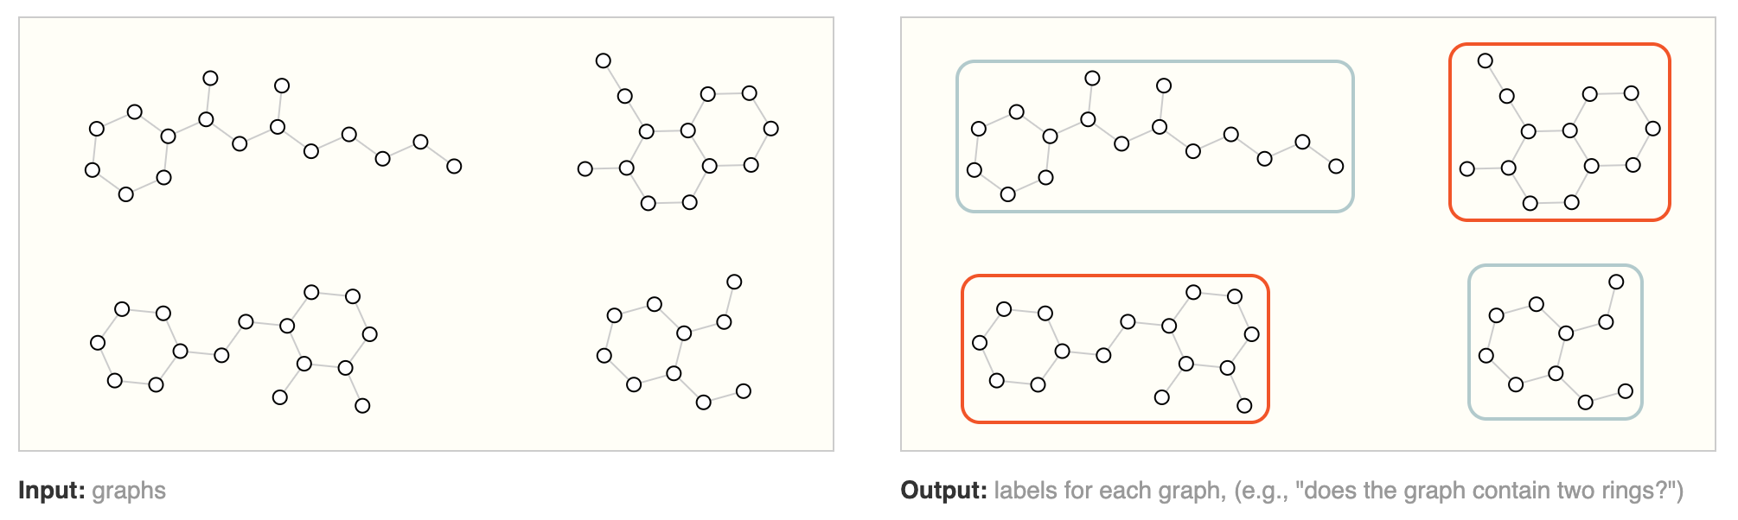
Graph-level task
In graph-level tasks, the goal is to predict a property of the entire graph.
Example: for a molecular graph, we may predict:
  The smell of the molecule
  Whether it binds to a disease-related receptor
This is similar to image classification:
  MNIST or CIFAR assigns one label to an entire image.
It is also similar to text classification:
  Sentiment analysis assigns one mood or emotion to an entire sentence.

Slide 10
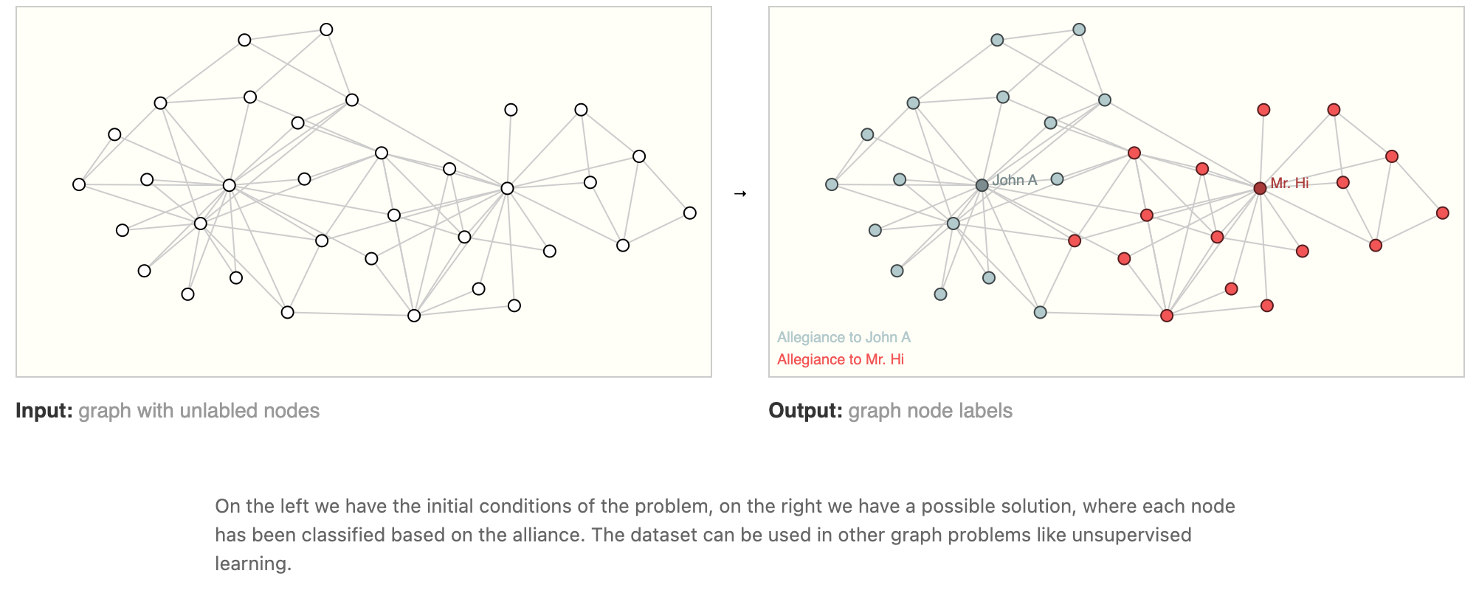
Node-level task
Node-level tasks predict the identity or role of each node in a graph.
Example: Zach’s Karate Club
  Nodes represent club members.
  Edges represent interactions between members.
  Goal: predict whether each member supports Mr. Hi or John H after the split.
A node’s distance from the instructor or administrator helps predict its label.å
Image analogy:
  Similar to image segmentation, where each pixel gets a label.
Text analogy:
  Similar to part-of-speech tagging, where each word is labeled as noun, verb, adverb, etc.

Slide 11
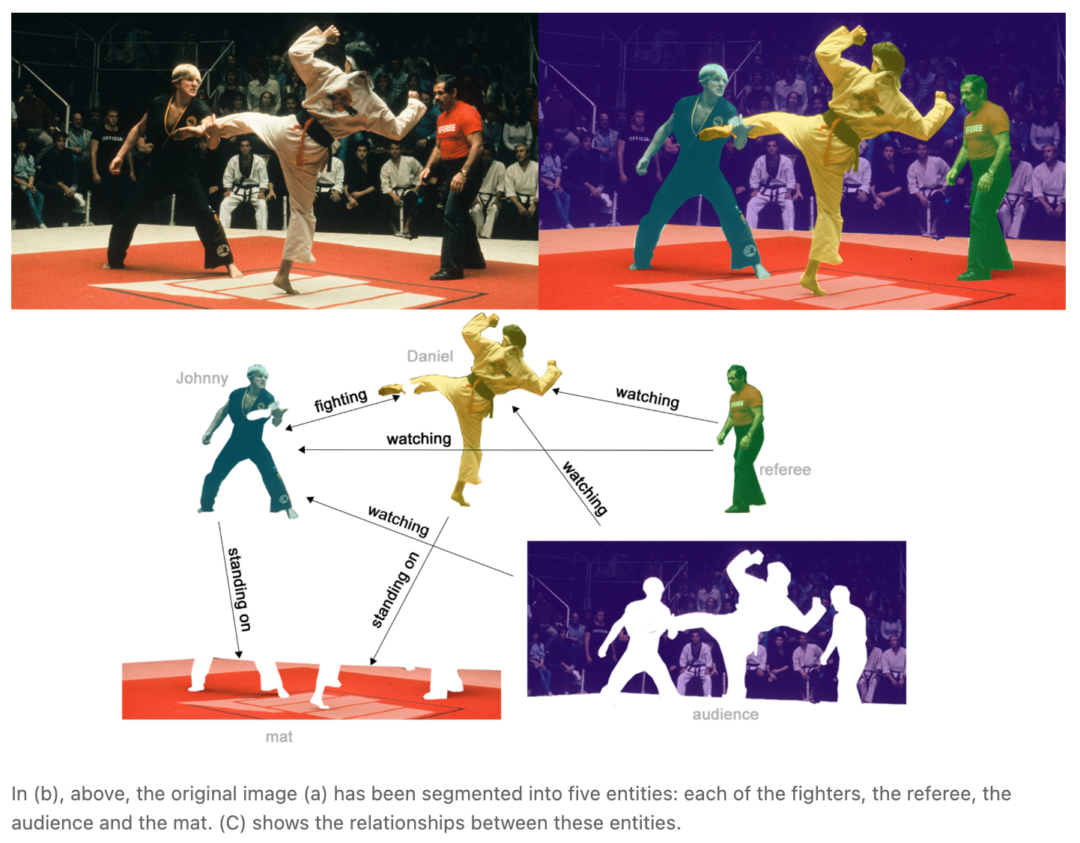
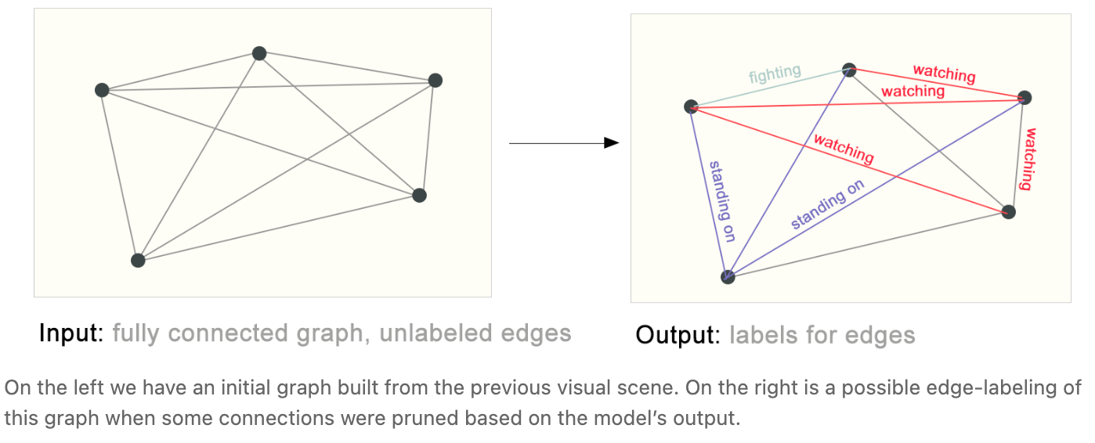
Edge-level task
Edge-level tasks predict relationships between nodes.
Example: image scene understanding
  Nodes represent objects in an image.
  Edges represent relationships between objects.
The goal is to predict:
  Whether two objects are connected
  What type of relationship they have
We can start with a fully connected graph.
Then, weak or irrelevant edges can be removed to create a sparse graph.

Slide 12
The challenges of using graphs in machine learning
Neural networks usually expect rectangular or grid-like inputs.
Graphs are harder to represent because they have irregular structures.
A graph may contain four types of information:
  Node features
  Edge features
  Global graph features
  Connectivity information
Node, edge, and global features can be stored in matrices.
Connectivity is more challenging to represent.
An adjacency matrix is a simple option, but it has drawbacks:
  Large graphs can have millions of nodes.
  Most adjacency matrices are very sparse.
  Sparse matrices waste memory.
  Different node orderings can create different adjacency matrices for the same graph.
Neural networks may treat these different adjacency matrices differently.
Therefore, graph models need to handle permutation invariance.

Slide 13
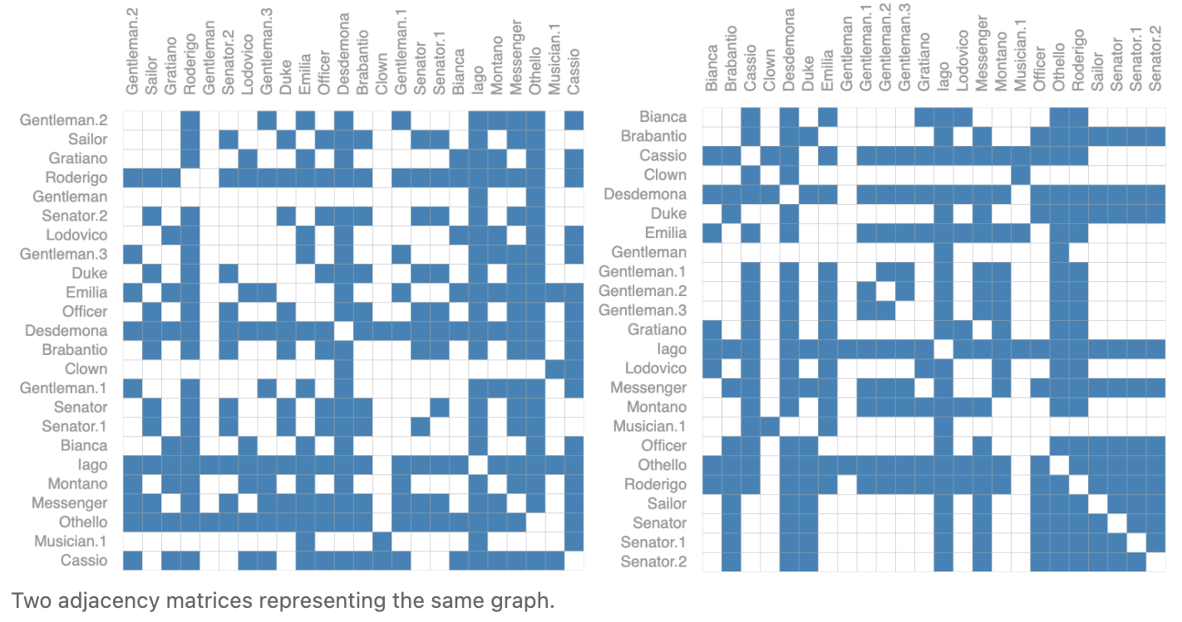
The challenges of using graphs in machine learning
For example, the Othello graph from before can be described equivalently with these two adjacency matrices. It can also be described with every other possible permutation of the nodes.

Slide 14
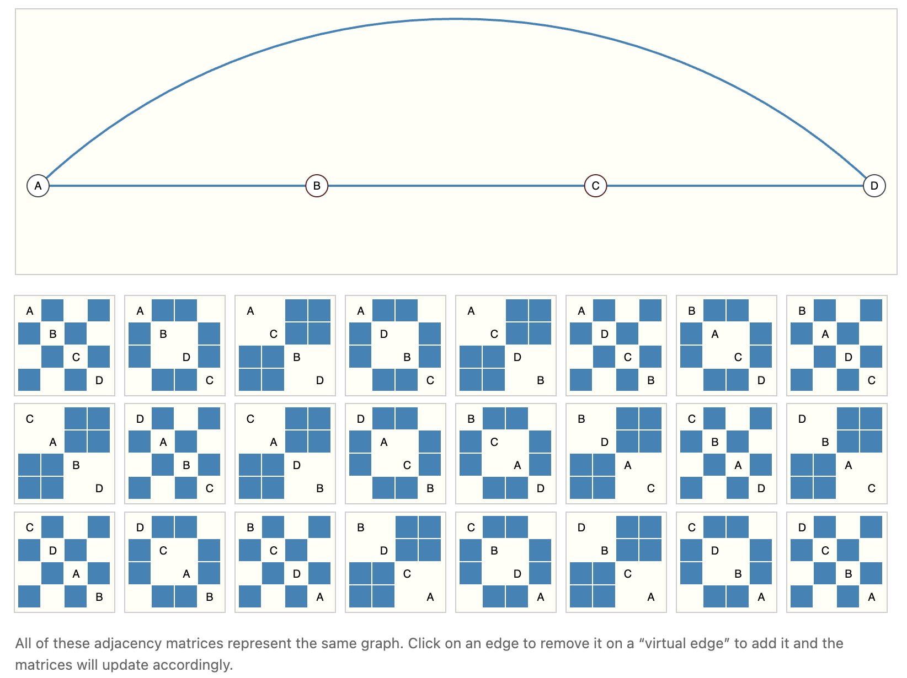
The challenges of using graphs in machine learning
The example below shows every adjacency matrix that can describe this small graph of 4 nodes. This is already a significant number of adjacency matrices, for larger examples like Othello, the number is untenable.

Slide 15
The challenges of using graphs in machine learning
Graphs contain different types of information:
  Node features
  Edge features
  Connectivity
  Global graph features
For sparse graphs, an adjacency list is more efficient than an adjacency matrix.
Each edge is stored as a pair of connected nodes:
  (source node, target node)
  Example: an edge between node i and node j is stored as (i, j).
  This avoids storing disconnected node pairs.
Storage complexity:
  Adjacency matrix: O(n_nodes²)
  Adjacency list: O(n_edges)
Since most real-world graphs are sparse, adjacency lists save memory and computation.

Slide 16
The challenges of using graphs in machine learning
Tensor Representation : A practical GNN representation usually uses four tensors:
Component | Shape | Meaning
Node features X | [n_nodes, d_n] | Feature vector for each node
Edge features E | [n_edges, d_e] | Feature vector for each edge
Adjacency list | [n_edges, 2] | Stores edge pairs (i, j)
Global feature u | [d_g] | Whole-graph feature vector

Slide 17
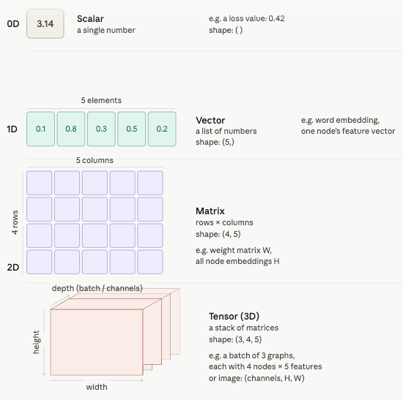

Slide 18
Each row in the node feature matrix corresponds to one node in the graph. Let’s say you have a molecule with 4 atoms. Each atom is a node. Each atom has 3 properties, for example, atom type (0 or 1), charge (0 or 1), and mass (a float).
The matrix X with shape (4, 3) stores all of this:
Row 0 = v₀'s features → [1, 0, 0.4]
Row 1 = v₁'s features → [0, 1, 0.7]
Row 2 = v₂'s features → [0, 0, 0.9]
Row 3 = v₃'s features → [1, 1, 0.2]
So when you see shape (n_nodes, d_node), n_nodes is the number of rows (one per node) and d_node is the number of columns (one per feature).
The reason this matters for GCN is that W^(k) · X is a single matrix multiplication that updates all nodes at once, it applies the same weight matrix to every row simultaneously. That is why GCN is efficient and scales regardless of graph size.

Slide 19
Building a GNN |Graph Neural Networks: Graph-In, Graph-Out
A Graph Neural Network (GNN) transforms graph attributes while preserving graph structure.
GNNs work with:
  Node features
  Edge features
  Global graph features
GNNs preserve graph symmetries, especially permutation invariance.
Many GNNs follow a message passing framework.
GNNs use a graph-in, graph-out architecture:
  Input: graph with node, edge, and global features
  Output: same graph structure with updated embeddings
  Connectivity remains unchanged

Slide 20
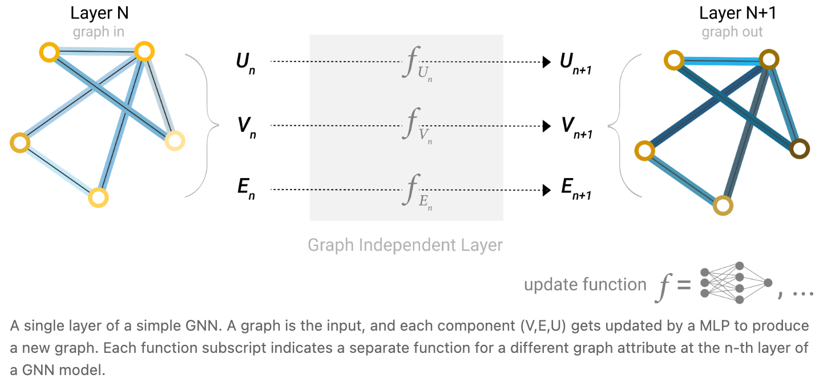
Building a GNN |Graph Neural Networks: Graph-In, Graph-Out
The Simplest GNN Layer
The simplest GNN updates each graph component independently.
It uses separate MLPs for:
  Node features
  Edge features
  Global features
Each node, edge, and global vector is passed through its own MLP.
The output graph has:
  The same adjacency list
  The same number of node, edge, and global feature vectors
  Updated node, edge, and global embeddings
GNN layers can be stacked like regular neural network layers.
This simple version updates embeddings, but does not yet use graph connectivity.

Slide 21
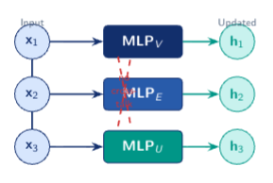
Building a GNN |Graph Neural Networks: Graph-In, Graph-Out
Apply separate MLPs to each graph attribute independently:
  MLP_V updates node embeddings.
  MLP_E updates edge embeddings.
  MLP_U updates the global graph vector.
The same MLP weights are shared across all nodes or edges.
The graph structure/connectivity is not used inside this layer.
Each node, edge, and global feature is updated in isolation.
The output graph keeps:
  The same nodes
  The same edges
  The same adjacency list
  Updated embeddings
Limitation: nodes do not receive information from their neighbors.
Connectivity is only used later during prediction through pooling.
Making Predictions with GNNs
After a GNN updates graph embeddings, we use them for prediction.
For binary node classification:
  Take each node embedding.
  Apply a linear classifier.
  Output a class label for each node.
This can also be extended to:
  Multi-class classification
  Regression tasks
Prediction is easy when the required information is already stored in the target component.
Example:
  Node prediction is straightforward if node embeddings contain useful information.

Slide 22
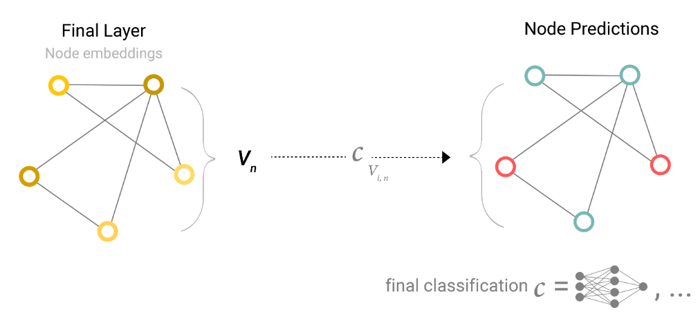
Node-level prediction using a GNN
On the left, we have the final GNN layer output. Each node already has a learned node embedding. These embeddings are shown as node vectors, represented by the yellow nodes.
The middle arrow shows a classifier being applied to each node embedding. In simple terms:
Take each node embedding v_n
Pass it through a classifier C
Produce a prediction for that node
So the GNN does not directly output the final class. First, it produces useful node embeddings. Then, a classifier converts those embeddings into labels.
On the right, we get node predictions. Each node is assigned a class label, shown using different colors. For example:
Teal nodes may represent one class.
Red nodes may represent another class.
A GNN learns node embeddings from the graph, then a classifier uses those embeddings to predict a label for each node.

Slide 23
Pooling - Routing Information for Prediction
Pooling is used when useful information is stored in one graph component, but prediction is needed in another.
Example:
  Edge features contain important information.
  But the task requires node-level prediction.
  So, edge information must be collected and passed to nodes.
Pooling transfers information across graph components:
  Edges → Nodes
  Nodes → Edges
  Nodes/Edges → Global
Pooling has two main steps:
  Gather: collect relevant embeddings from neighbors or graph components.
  Aggregate: combine them into one representation.
The aggregation function should be permutation-invariant.
Common aggregation method:
  Sum pooling
For any prediction task:
  Identify where the useful data is stored.
  Identify where the prediction is needed.
  Define the correct pooling rule.
Pooling helps combine information from nodes, edges, and global context for prediction.
It is a reusable building block for more advanced GNN models.

Slide 24
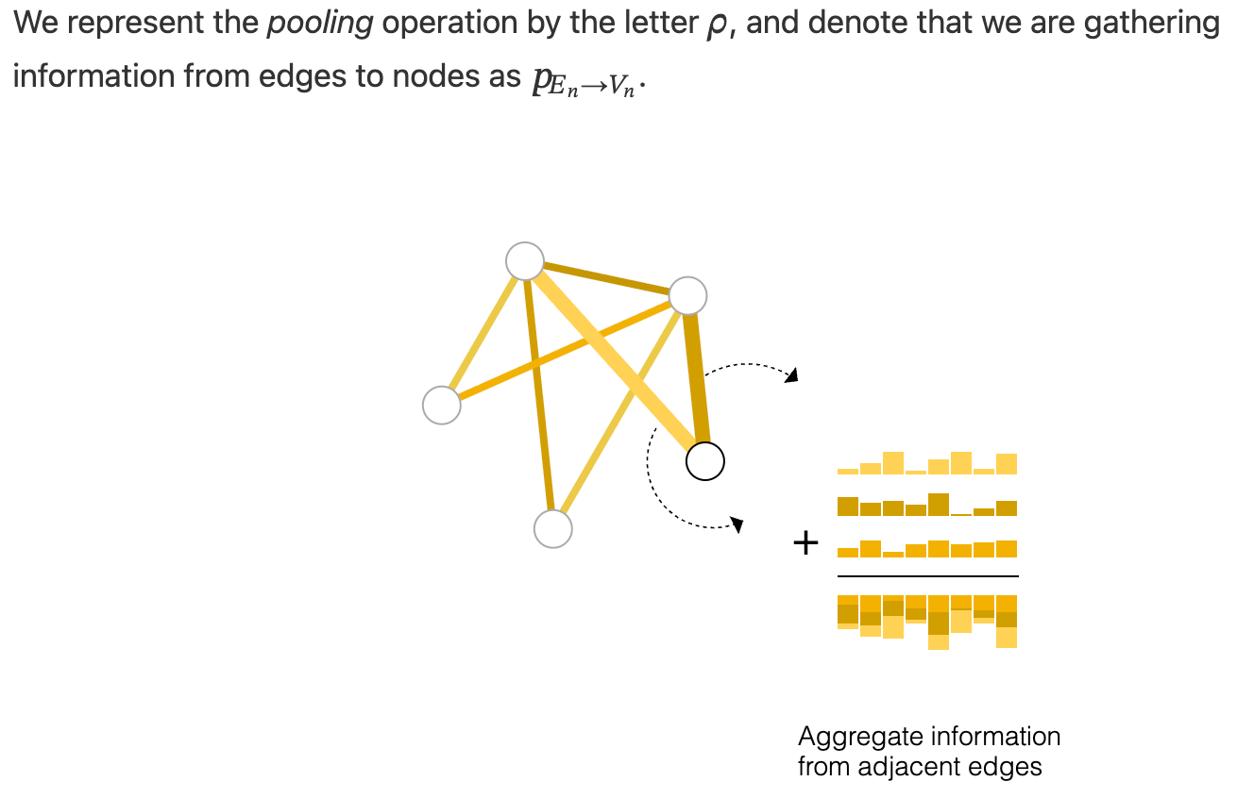
Pooling

Slide 25
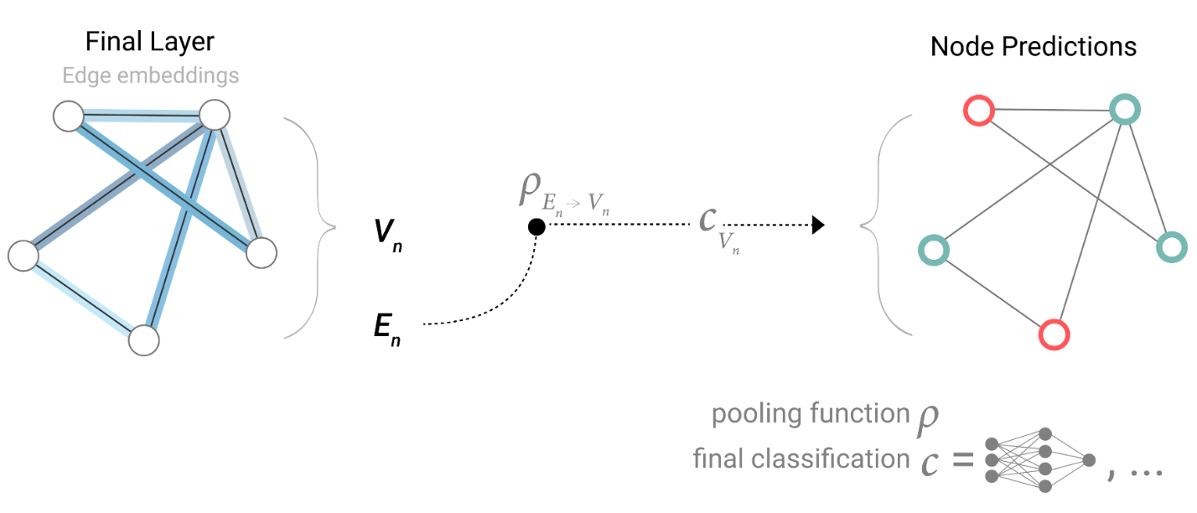
Only have edge-level features
If we only have edge-level features, and are trying to predict binary node information, we can use pooling to route (or pass) information to where it needs to go. The model looks like this.
Final GNN layer contains meaningful edge embeddings.
Nodes do not yet have useful features.
Task: make node-level predictions.
Goal: classify each node into one of two classes.
Since data is in edges but prediction is on nodes, use edge-to-node pooling.
For each node v:
  Gather: collect embeddings of all edges connected to node v.
  Aggregate: combine them into one node-level context vector using sum or mean.
  Classify: pass the context vector through an MLP to predict the node label.

Slide 26
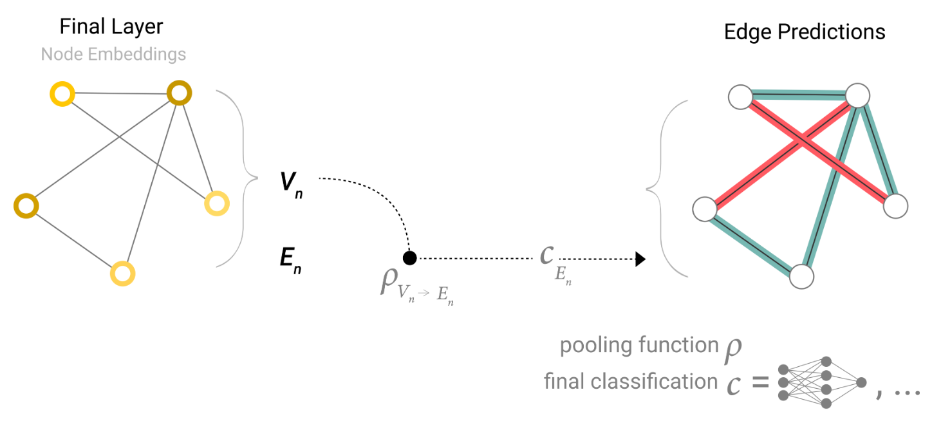
Only have node-level features
If we only have node-level features, and are trying to predict binary edge-level information, the model looks like this.
Final layer contains only node embeddings.
Edges have no features.
Task: make edge-level predictions.
Goal: classify each edge into one of two classes.
Since data is in nodes but prediction is on edges, use node-to-edge pooling.
For each edge (u, v):
  Gather: collect embeddings of endpoint nodes u and v.
  Aggregate: combine them into one edge-level context vector.
  Classify: pass the context vector through an MLP to predict the edge label.

Slide 27
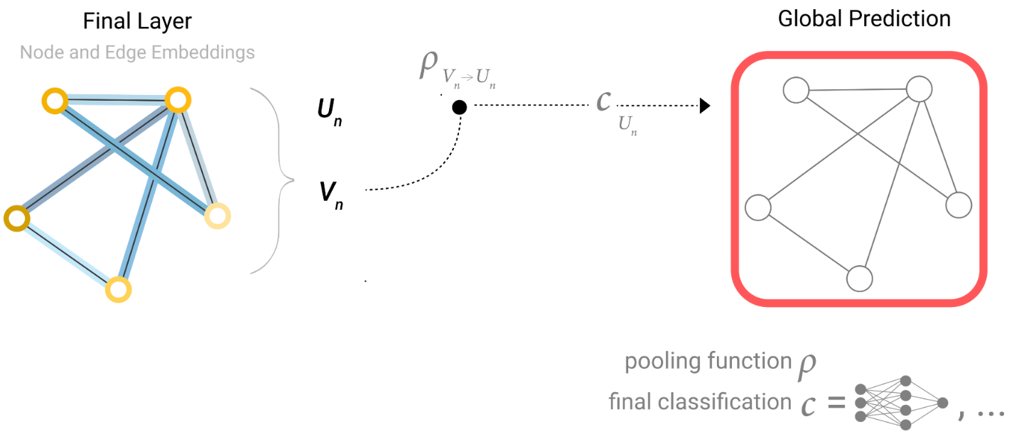
Only have node-level features
If we only have node-level features, and need to predict a binary global property, we need to gather all available node information together and aggregate them. This is similar to Global Average Pooling layers in CNNs. The same can be done for edges.
Node and edge embeddings exist, but one graph-level prediction is needed.
Final GNN layer contains:
  Node embeddings
  Edge embeddings
Task: make a single binary prediction for the entire graph.
Goal: classify the whole graph into one of two classes.
Since prediction is for the whole graph, use global pooling.
For graph-level prediction:
  Gather: collect embeddings from all nodes in the graph.
  Aggregate: combine them into one global context vector using sum or mean.
  Classify: pass the global vector through an MLP to predict the graph label.
The same process can also be done using edge embeddings instead of node embeddings.

Slide 28
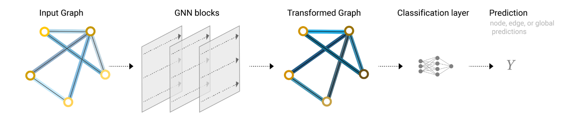
An end-to-end prediction task with a GNN model
In our examples, the classification model 𝑐 can easily be replaced with any differentiable model, or adapted to multi-class classification using a generalized linear model.
Limitation of the Simplest GNN
In the simplest GNN layer, graph connectivity is not used during embedding updates.
Each graph component is processed independently:
  Each node is updated separately.
  Each edge is updated separately.
  The global context is updated separately.
Connectivity is only used later during pooling for prediction.
This means the model does not fully exploit the graph structure inside the GNN layer.
More advanced GNNs use connectivity directly during message passing.

Slide 29
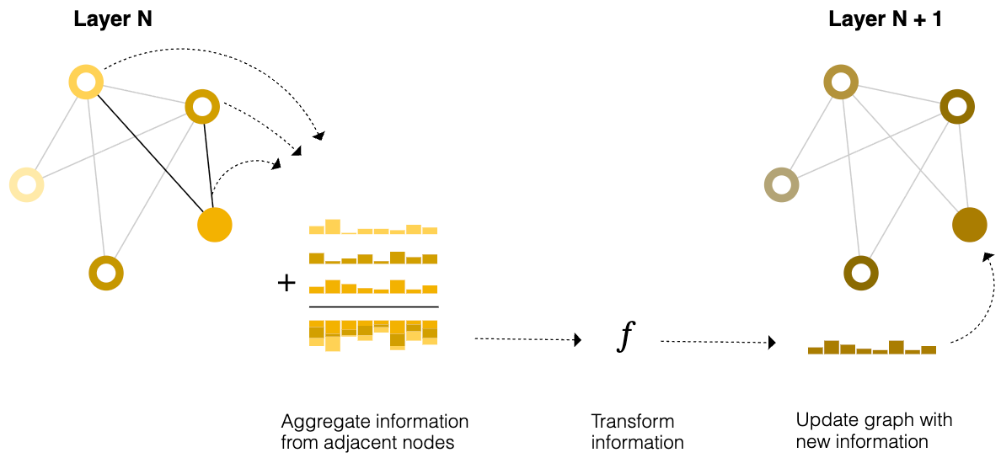
Message Passing in GNNs
Message passing brings graph connectivity inside the GNN layer.
Instead of updating each node independently, a node receives information from its neighbors.
Neighboring nodes or edges exchange information and influence each other’s updated embeddings.
This makes learned embeddings aware of the graph structure.
Message passing can happen between:
  Nodes and nodes
  Edges and nodes
  Nodes or edges and global graph features

Slide 30
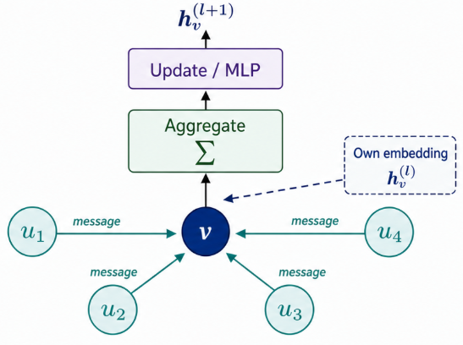
Message Passing Steps
Message passing usually has three steps:
Gather
  Collect embeddings/messages from neighboring nodes or edges.
Aggregate
  Combine the collected messages using a permutation-invariant function.
  Common choices: sum, mean, or max.
Update
  Pass the aggregated message through a learned update function, usually an MLP.
  This produces the updated node embedding.
This sequence forms one basic message-passing GNN layer.
The aggregation must be permutation-invariant so the output does not depend on node ordering.
new node embedding = MLP(own embedding + aggregated neighbor messages)

Slide 31
Message Passing as Graph Convolution
Stacking Message Passing Layers
One message-passing layer allows a node to use information from its 1-hop neighbors.
Stacking layers increases the node’s receptive field.
After k message-passing layers, a node can use information from its k-hop neighborhood.
Example:
  After 1 layer: information from immediate neighbors
  After 2 layers: information from neighbors of neighbors
  After 3 layers: information from nodes three steps away
By stacking GNN layers, a node can gradually incorporate information from larger parts of the graph.
Message passing is similar to convolution in CNNs.
In CNNs:
  A filter looks at a local pixel/feature window.
  It combines nearby values using learned weights.
  It produces a new value in the output feature map.
In GNNs:
  A node gathers messages from neighboring nodes.
  It aggregates those messages.
  It updates its own embedding.
Key difference:
  CNN neighborhoods are usually fixed, such as 3 × 3.
  Graph neighborhoods are irregular and can have different numbers of neighbors.
Therefore, GNNs need permutation-invariant aggregation functions such as:
  sum
  mean
  max

Slide 32
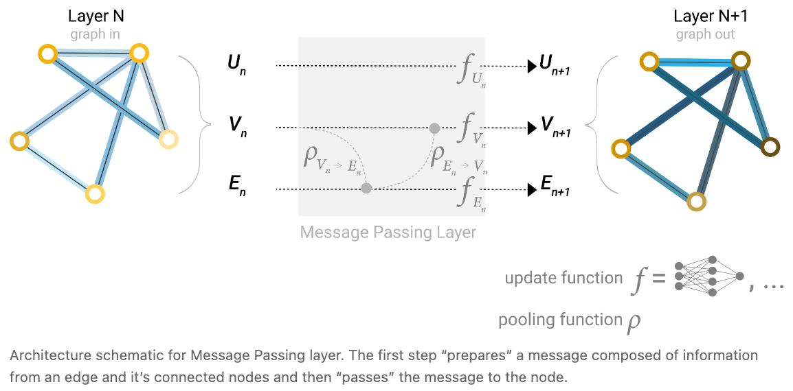
Learning Edge Representations
Graph datasets may not contain all information types:
  Node features
  Edge features
  Global features
Sometimes, useful information is stored in edges, but prediction is needed on nodes.
Instead of using pooling only at the final prediction step, message passing can share information inside the GNN layer.
Edge information can be used to update node embeddings.
Basic idea:
  Pool information from neighboring edges.
  Transform it using an update function.
  Store the result as updated node or edge embeddings.
This allows nodes and edges to influence each other during learning.

Slide 33
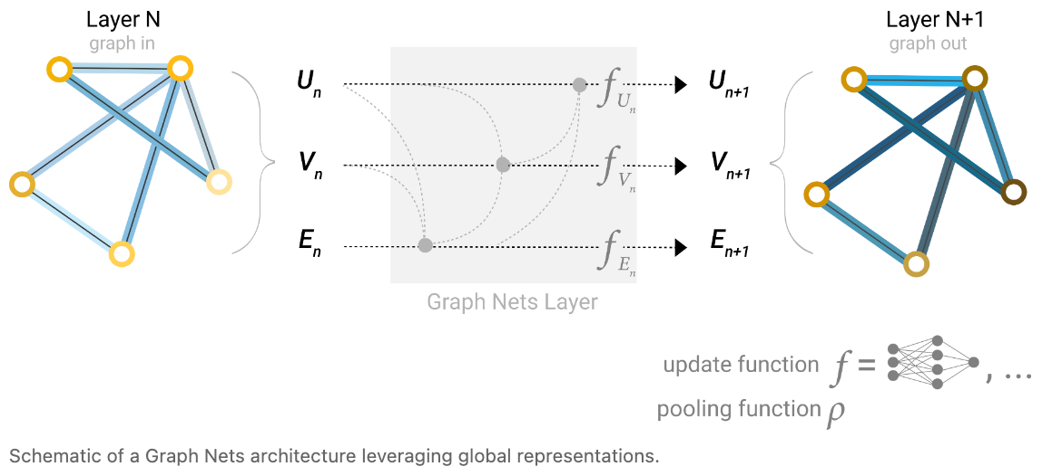
Adding Global Representations
Message passing has a limitation:
  Information only travels a limited number of hops per layer.
  After k layers, a node can receive information from at most k steps away.
This is a problem when prediction depends on distant nodes or whole-graph context.
Fully connecting all nodes could solve this, but it is computationally expensive for large graphs.
A better solution is to use a global graph representation.
The global representation is also called:
  Global context vector
  Master node
It is connected to all nodes and edges.
It acts as a bridge for passing information across distant parts of the graph.
This helps the model learn a richer representation of the whole graph.

Slide 34
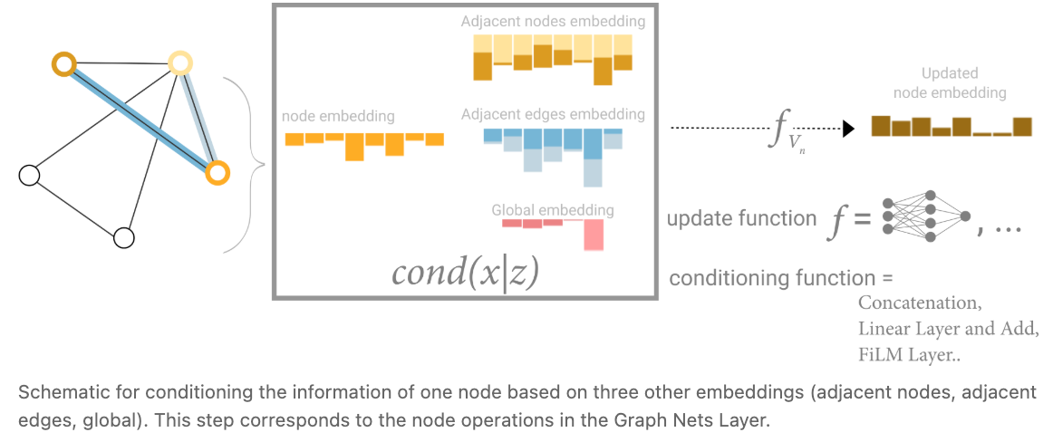
Conditioning with Global Information
All graph attributes can have learned representations:
Node embeddings
Edge embeddings
Global embeddings
During pooling, we can condition one attribute using information from other attributes.
Example: to update one node, we can use:
Neighboring node embeddings
Connected edge embeddings
Global graph embedding
These sources help the node update use both local and global information.
The information can be combined by:
Concatenating the embeddings
Mapping them to the same space and adding them
Using feature-wise modulation
The combined representation is passed to an update function.
This produces a new node embedding with richer graph context.

Slide 35
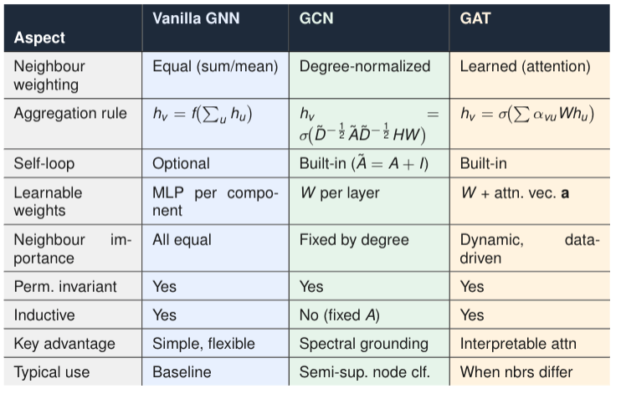
How GNN become GCN and GAT

Slide 36
How GNN become GCN and GAT : Only the aggregation weight differs
All three use: gather neighbors → aggregate → update via MLP. The only difference is the weight each neighbor gets.
GNN — weight = 1 (uniform, all neighbors equal)
GCN — weight = 1/√(N(v), fixed, derived from node degrees. High-degree nodes get down-weighted. Like CNN average pooling but on a graph.
GAT — weight = α_vu, learned via a small attention network over concatenated neighbor features. The model decides which neighbors matter more.
 | GNN | GCN | GAT
Weight | 1 | 1/√(N(v)) | learned α
Uses structure | No | Yes (degree) | Yes (features)
Learnable agg. | No | No | Yes

Slide 37
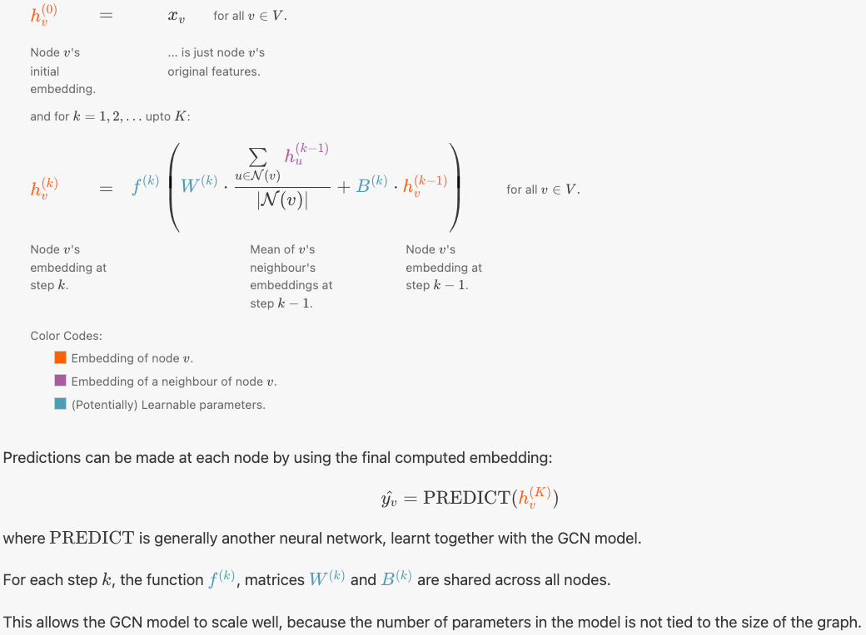
GCN

Slide 38
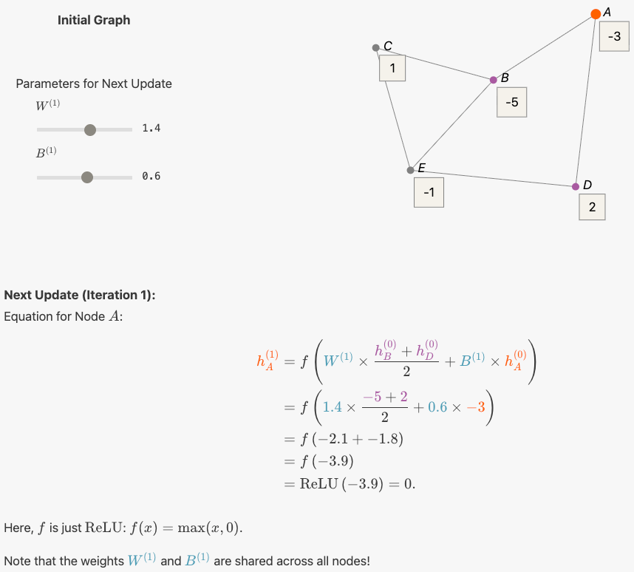
GCN

Slide 39
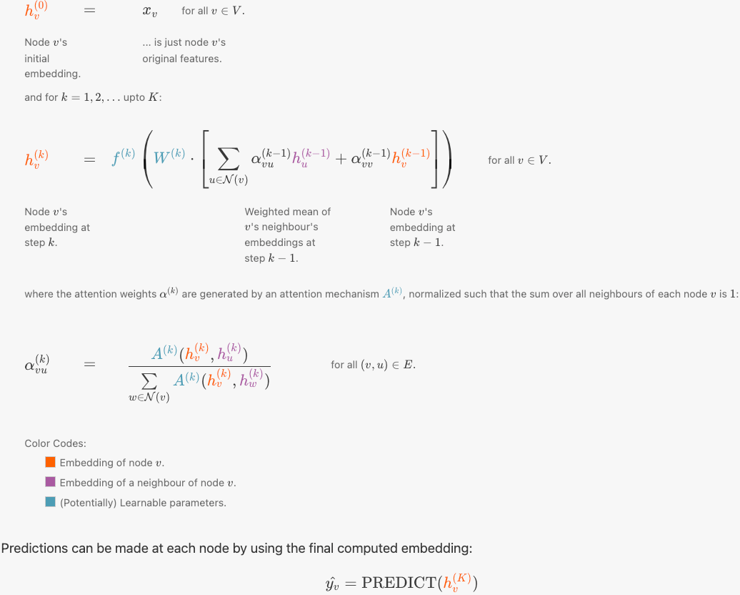
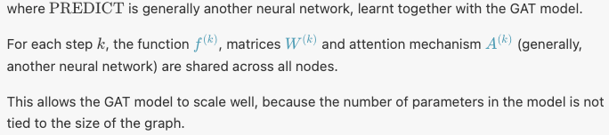
GAT

Slide 40
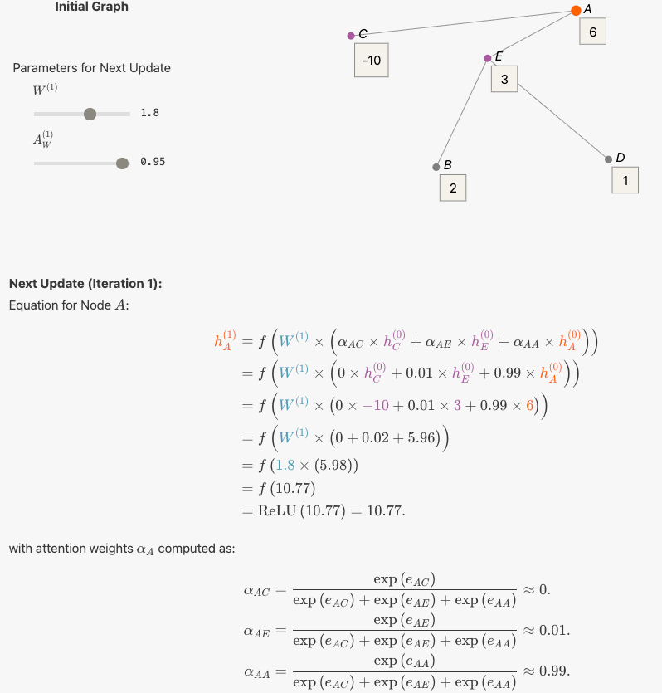
GAT

Slide 41
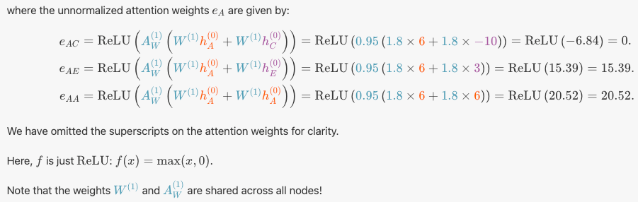
GAT

Slide 42
Reference
https://distill.pub/2021/gnn-intro/
https://distill.pub/2021/understanding-gnns/

